Slide 1

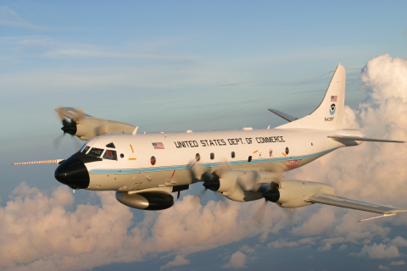
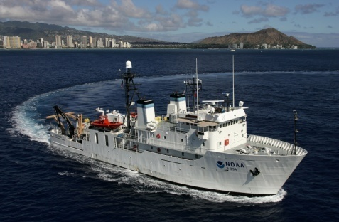
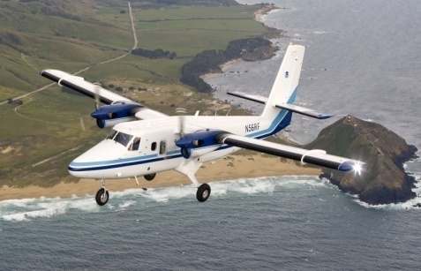
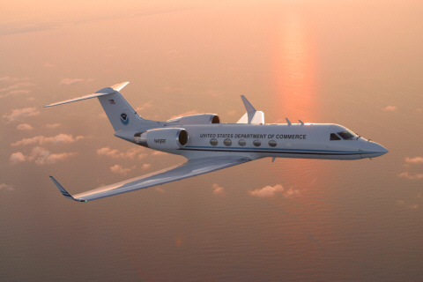
69th Interdepartmental Hurricane Conference
March 3, 2015
CAPT Harris B. Halverson II, NOAA
Commanding Officer
NOAA Aircraft Operations Center
.

Slide 2
AGENDA
The Current Fleet of NOAA Aircraft
2014 Hurricane Season – A Tale of Two Oceans
FY15 Aircraft Services Flight Hour Allocation Plan
P-3 Service Life Extension Program
Re-winging of the P-3s
Engine Upgrade
Avionics Upgrades

Slide 3
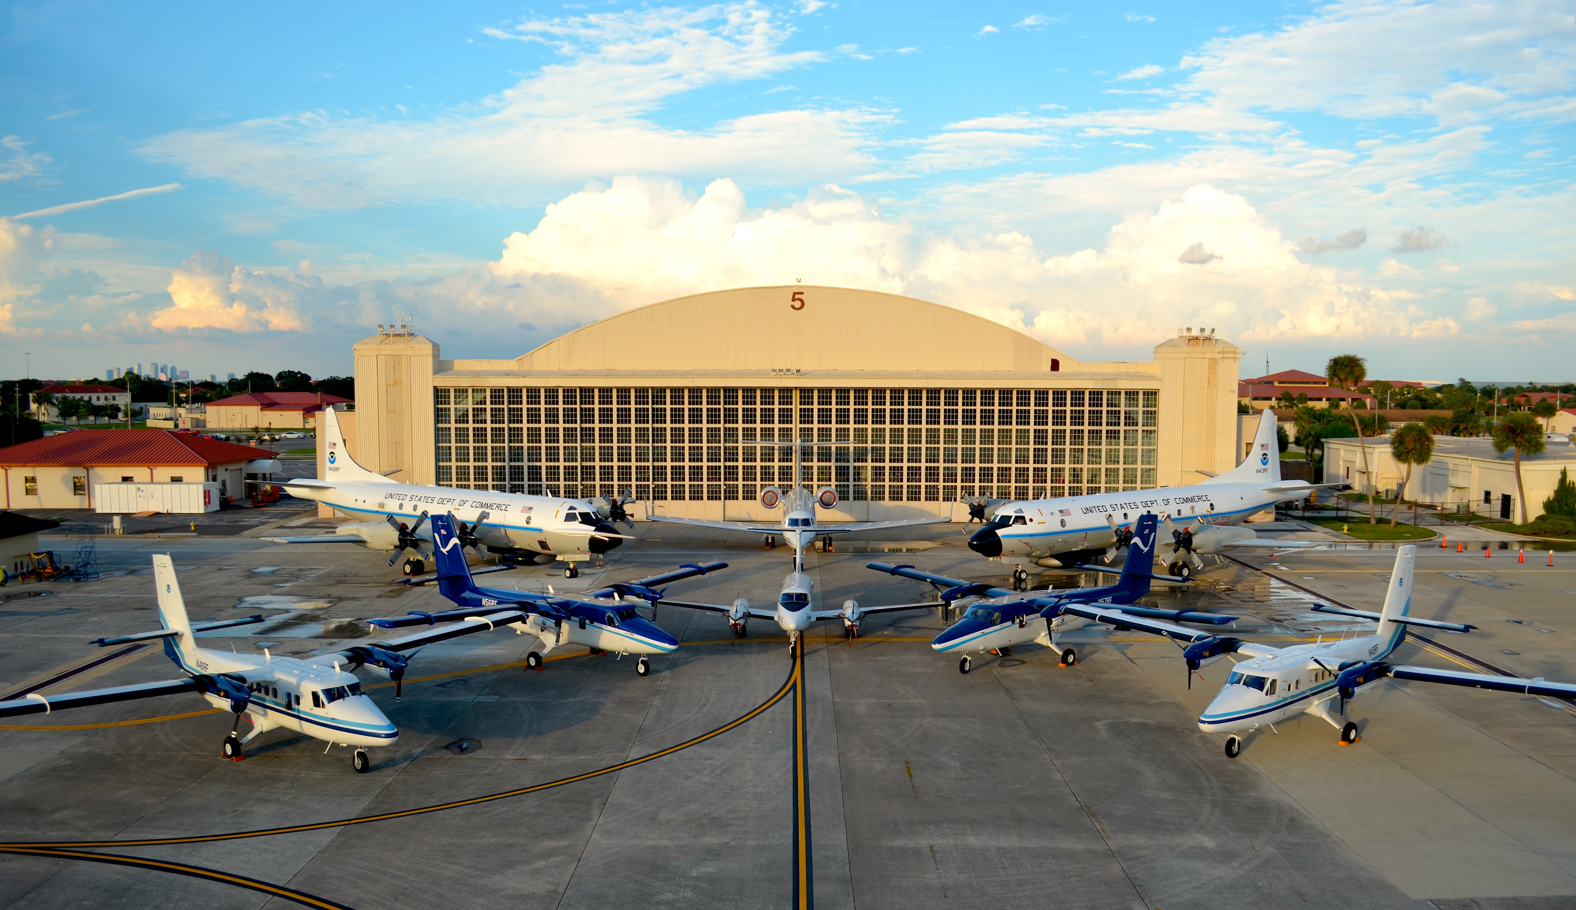

Slide 4
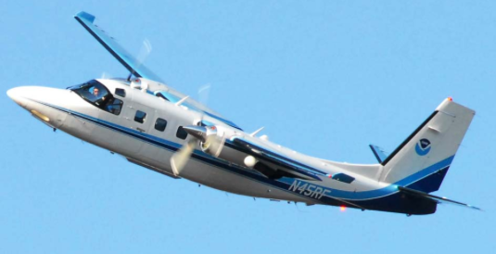
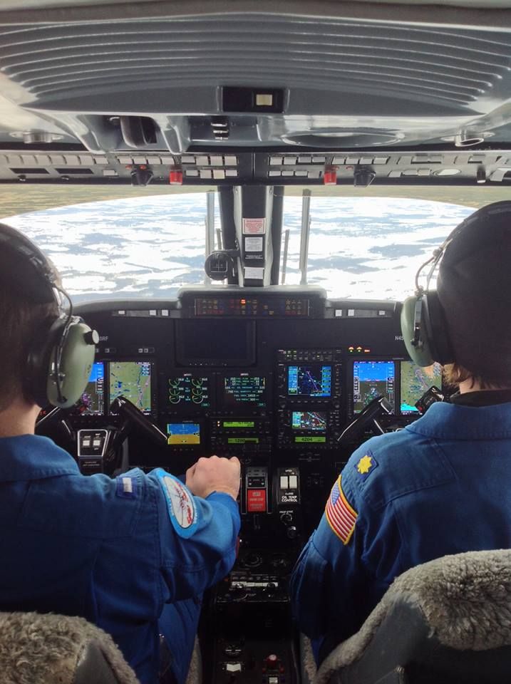
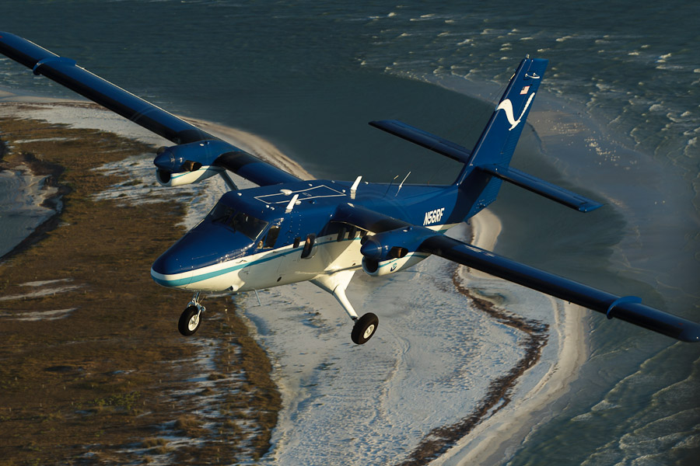
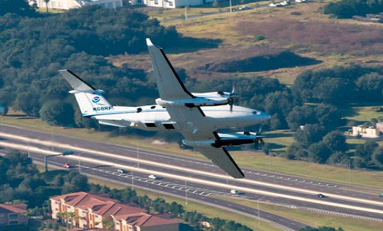
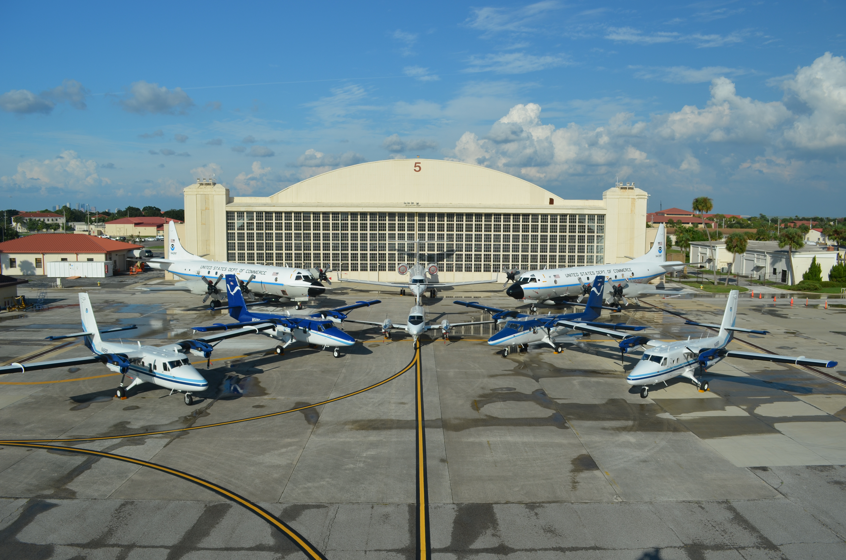
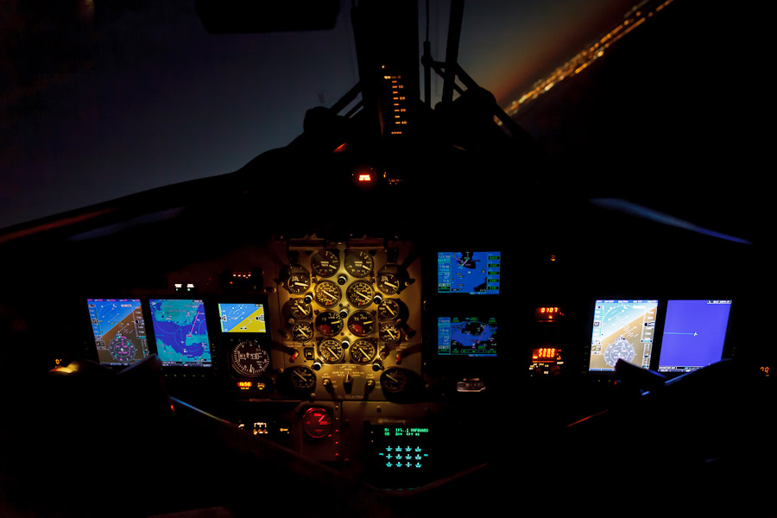
Light Aircraft Fleet
(4) DHC-6-300 Twin Otters
(1) AC-695A Turbo Commander
(1) BE-350CER King Air

Slide 5
The 2014 Hurricane Season
A Tale of Two Oceans

Slide 6
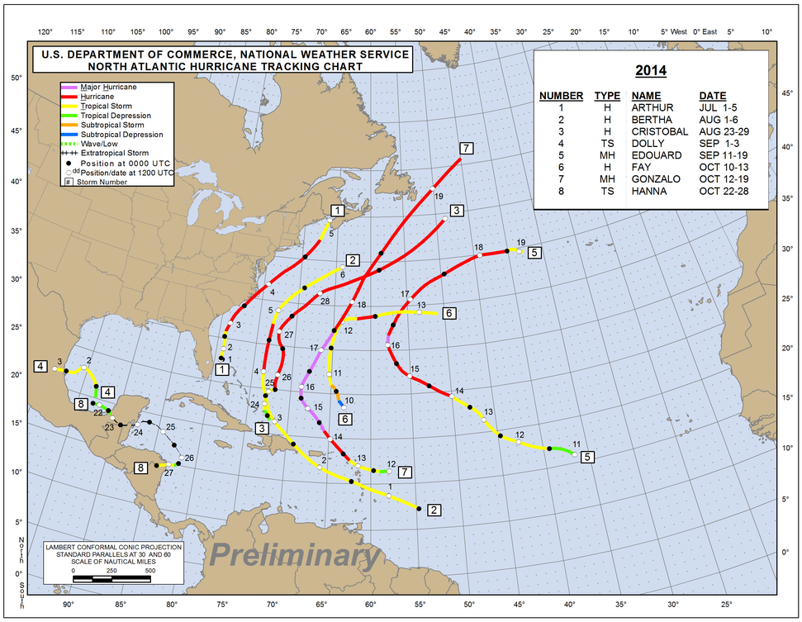

Slide 7
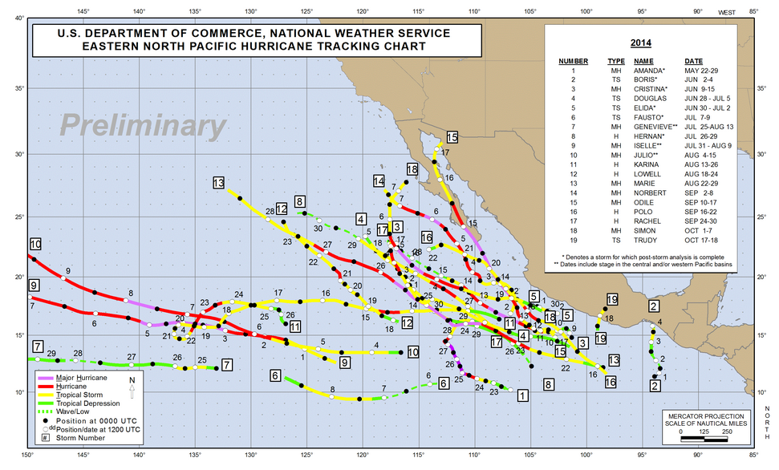

Slide 8
Hurricane Hours Flown
2008-2013

Slide 9
2014 HURRICANE SEASON
P-3 299.5 Hrs.
G-IV 160.1 Hrs.
Total 459.6 Hrs

Slide 10
Hurricane Hours Flown
2008-2014

Slide 11
STORMS FLOWN BY NOAA AIRCRAFT
ATLANTIC: ARTHUR P-3/G-IV
BERTHA P-3
CRISTOBAL P-3
EDOUARD P-3/G-IV
GONZALO P-3
E. PACIFIC ISELLE G-IV
JULIO G-IV
SIMON P-3
C. PACIFIC ANA G-IV

Slide 12
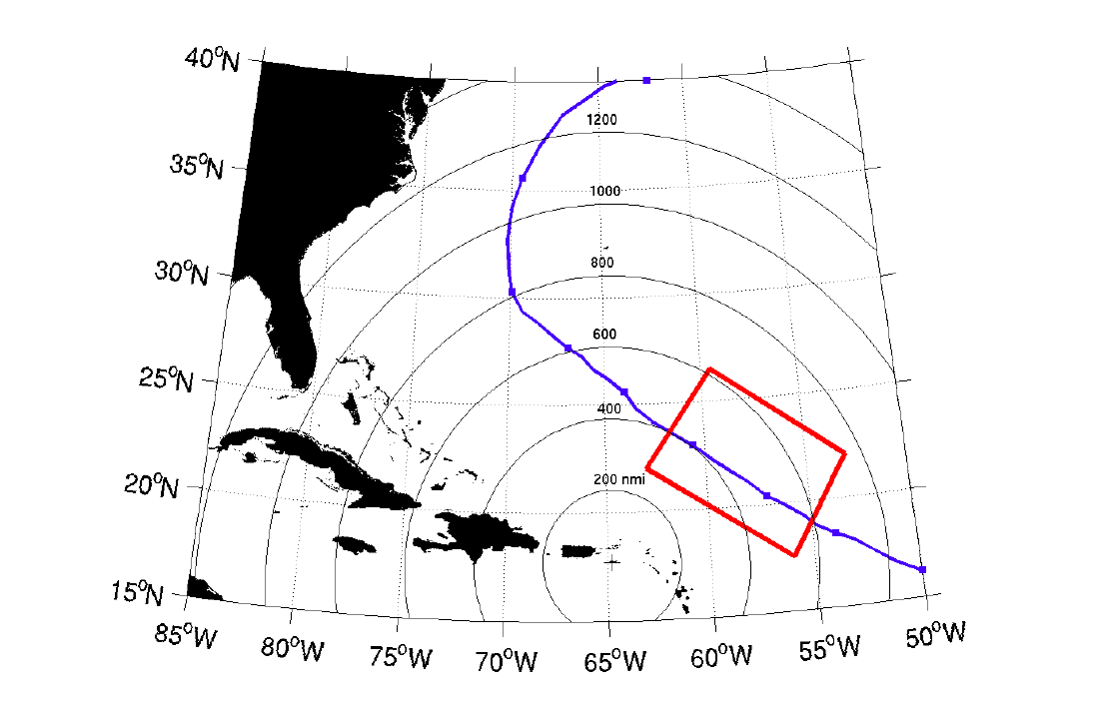
MODEL EVALUATION EXPERIMENT
The ideal experiment consists of coordinated three-plane missions designed to observe several mechanisms responsible for modulating convective activity, hurricane structure and storm intensity change

Slide 13
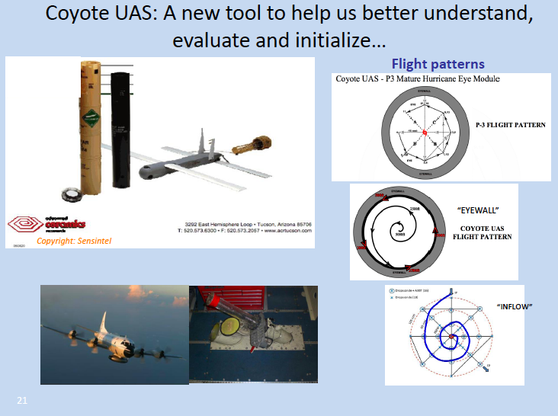

Slide 14
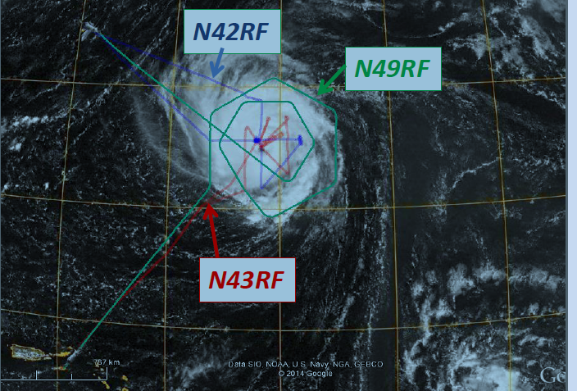
Hurricane Edouard 9/15/2014

Slide 15
P-3 HURRICANE OPERATIONS from
MEXICO

Slide 16
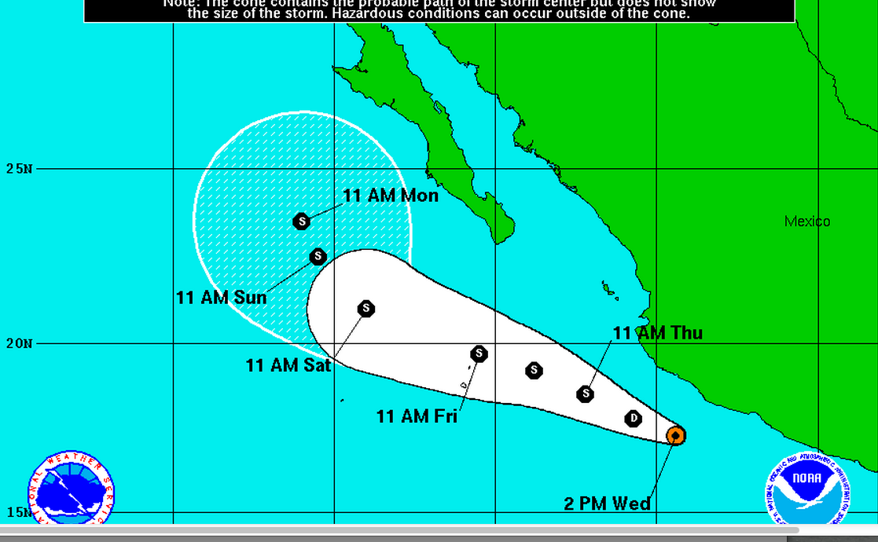

Slide 17
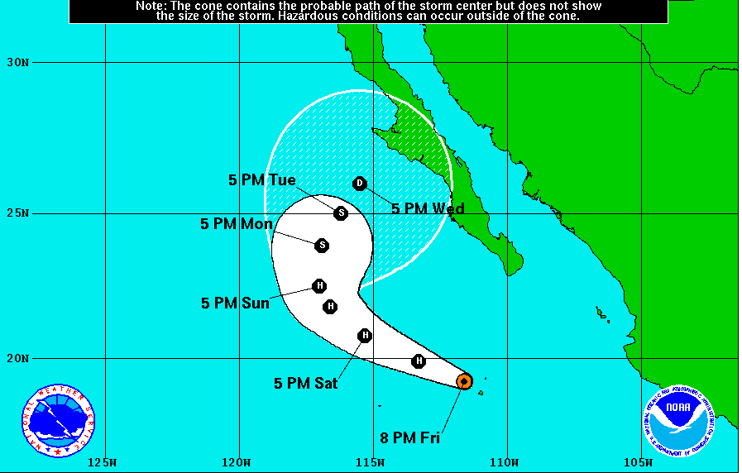

Slide 18
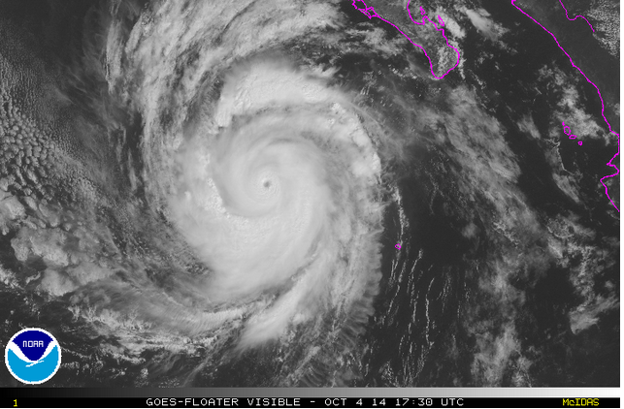

Slide 19
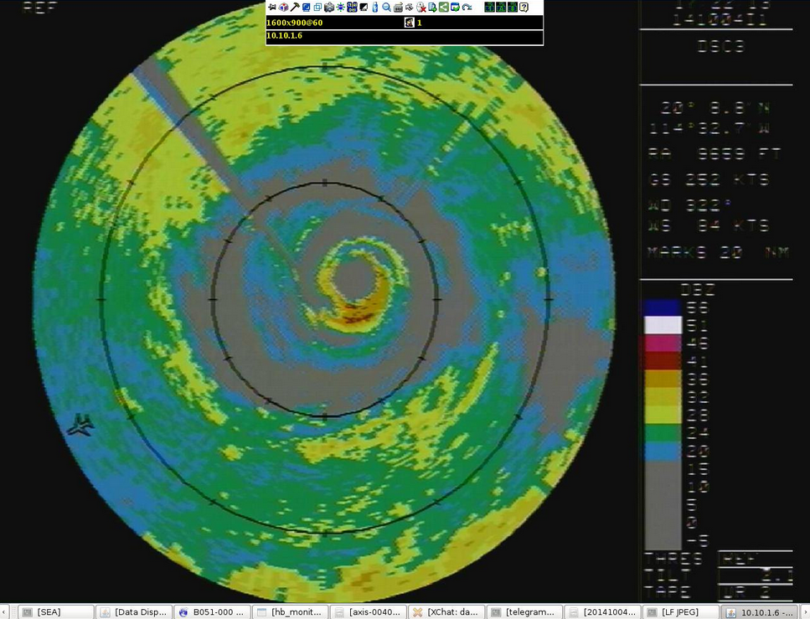

Slide 20
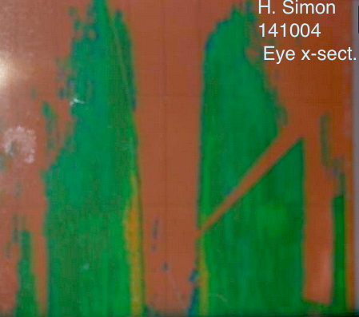

Slide 21
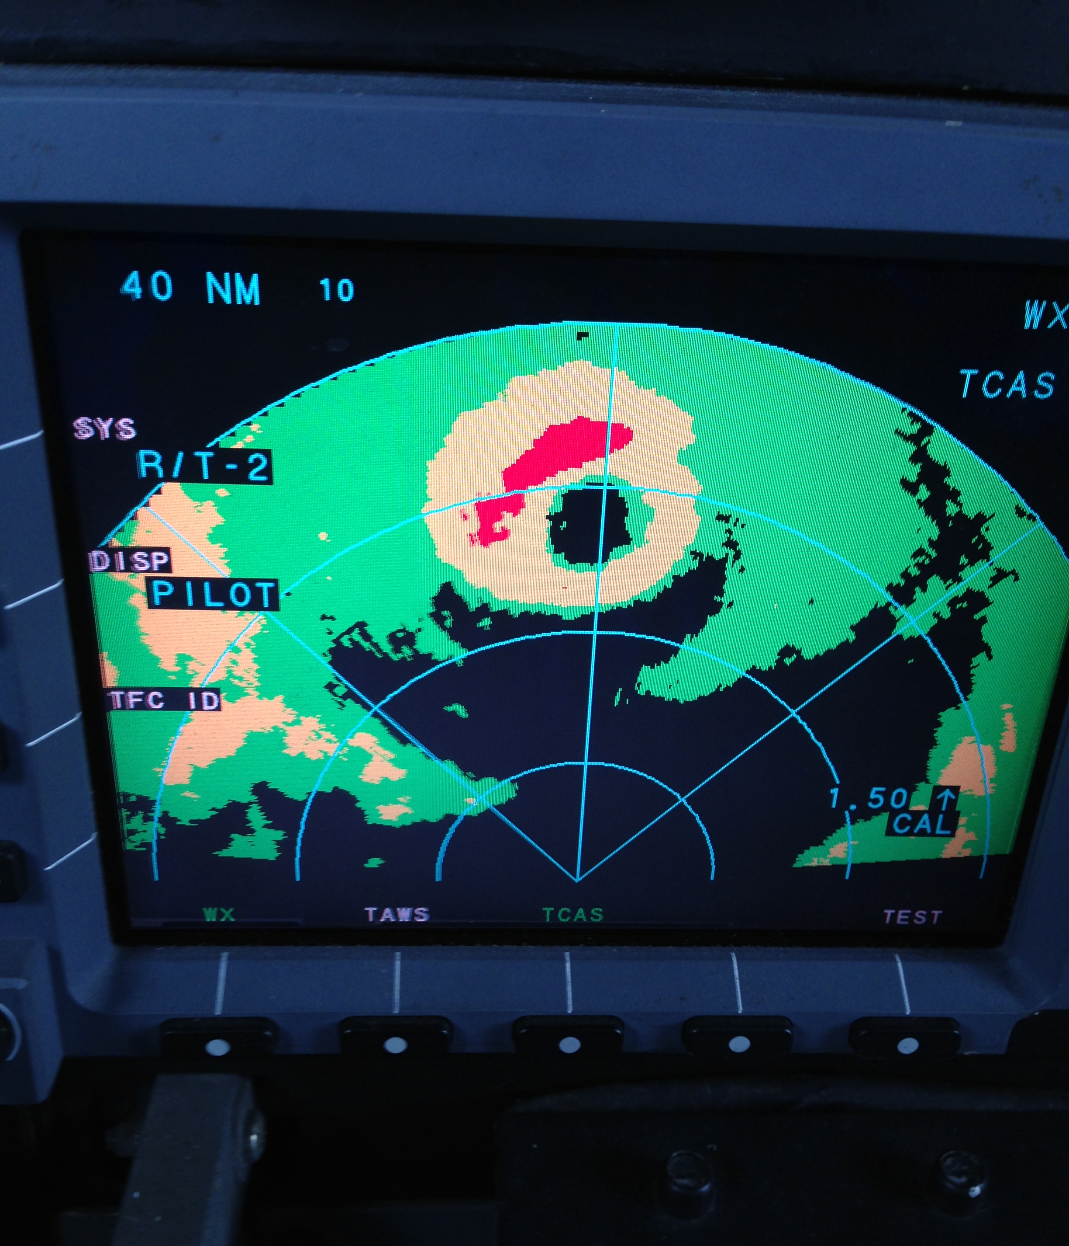

Slide 22
The Approved FY 2015
NOAA Aircraft Schedule

Slide 23
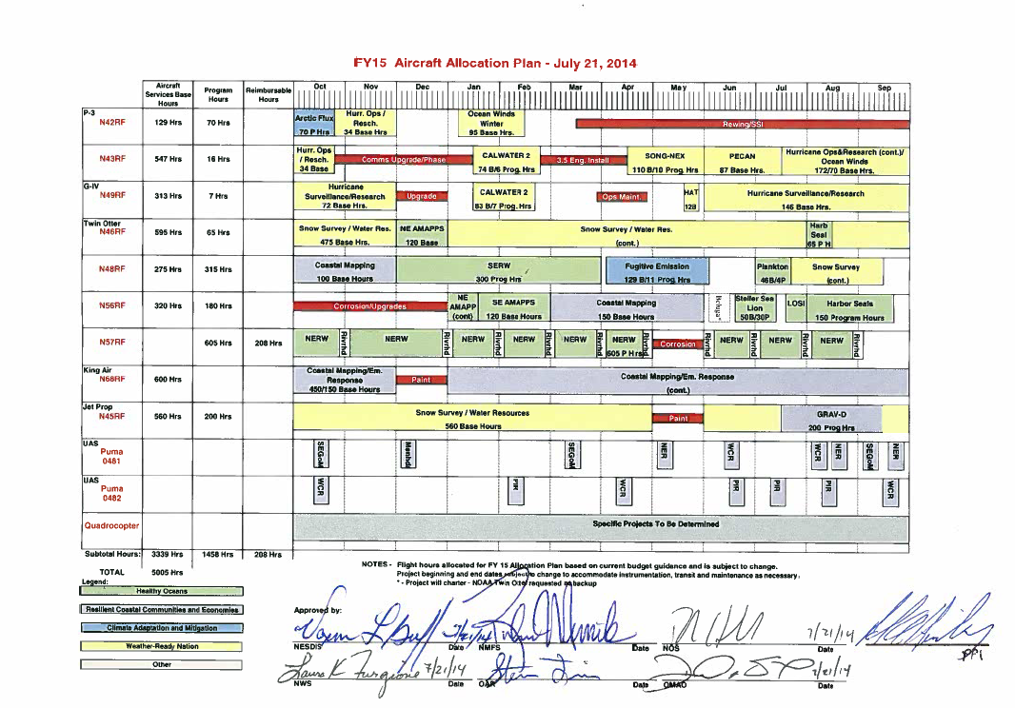
FY14 AOC Accomplishments
Increased interagency collaboration with the installation and field testing in Costa Rica of NASA’s EcoSAR P-band radar on a NOAA P-3.
Collaborated with the NASA HS3 and ATREX Global Hawk program, providing GH pilots and technical support in Guam, California and Wallops Island

Slide 24
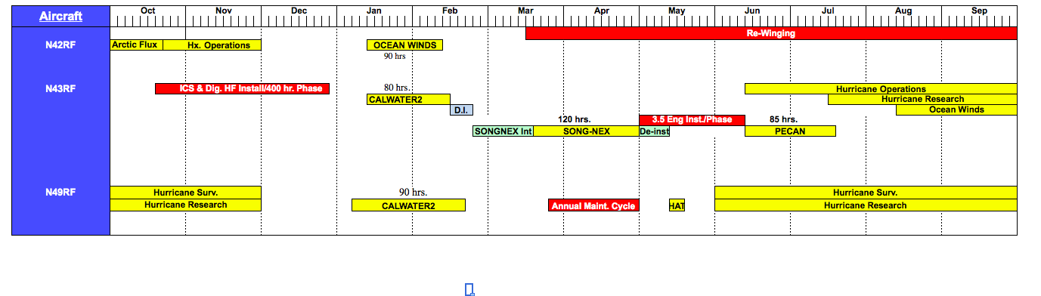
FY15 HEAVY AIRCRAFT SCHEDULE

Slide 25
SONGNEX Operating Areas
Notes:
Least costly option.
High risk for missing hurricane season tasking..
2015 and 2019 season not covered.
42 chosen based on SLAP findings, costs, and schedule.
Assumes 300 hours per year on active aircraft.

Slide 26
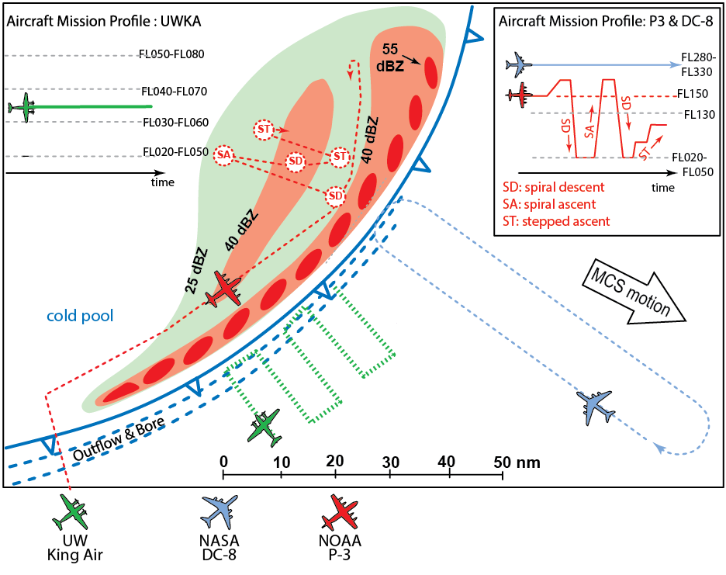
Plains Enhanced Convection At Night (PECAN)
Notes:
Least costly option.
High risk for missing hurricane season tasking..
2015 and 2019 season not covered.
42 chosen based on SLAP findings, costs, and schedule.
Assumes 300 hours per year on active aircraft.

Slide 27
P-3 Re-winging
and
Service Life Extension

Slide 28
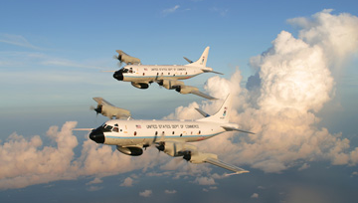
WP-3D Service Life Extension – Executive Summary
$326M to NOAA to Address Sandy Mitigation Efforts ($42.3M to OMAO after sequestration)
OMAO: Four (4) multi-year projects requiring collaboration with multiple governmental groups and commercial industry
Project Areas:
  WP-3D Re-Wing Kits
    Outer Wing
    Horizontal Stabilizer
  Re-Wing Kit Installation
  T56-A-14 Engine Refresh
    Overhaul to Zero Time
    Series III Reliability Enhancements
    Series 3.5 Engine Enhancement Package
  Avionics Upgrades

Slide 29
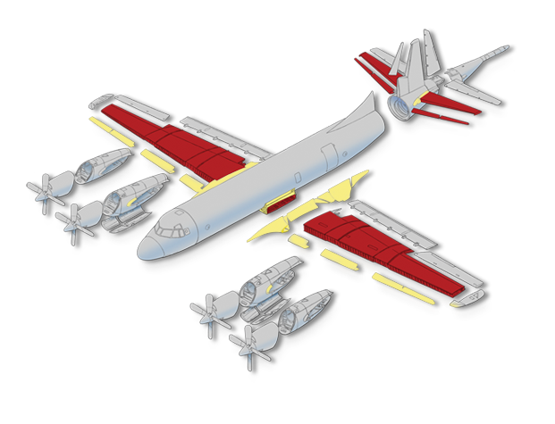
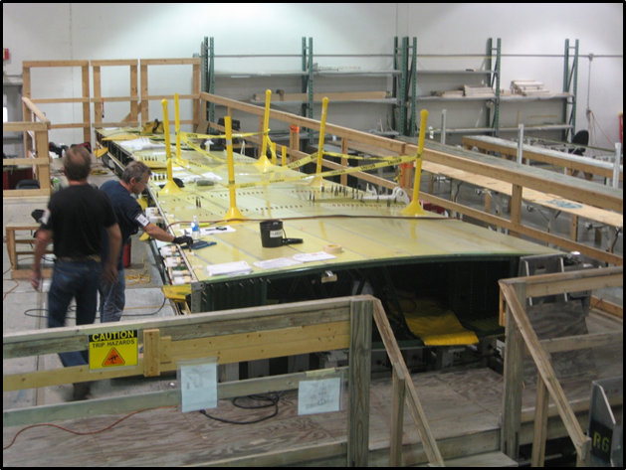
WP-3D Service Life Extension – Rewing Kits
Scope
  New Outer wing assemblies
  New Center Wing Lower surface
  New Horizontal Stabilizer
  Digital Fuel Quantity System
  New EF5992 Fuel Tank Sealant
  Timeline
  Rewing Kit #1 Delivery January 2015
  Installation on N42RF March 2015-May 2016
  Rewing Kit #2 Delivery February 2016
  Installation on N43RF August 2016-August 2017
  Partners
  NAVAIR PMA-290 (Interagency Agreement for Assisted Acquisition) for Contracting
  L-3 Systems for Rewing Kit Build
  Navy Fleet Readiness Center Southeast for Installation
  Benefits
  Additional 7,500 Flight Hours
  Additional 15-20 years of Service Life
  Increased operational flight time
  Increased mission readiness
  Elimination of extra Special Structural Inspections (SSI)
  Reduce future costs of Depot Level Maintenance events

Slide 30
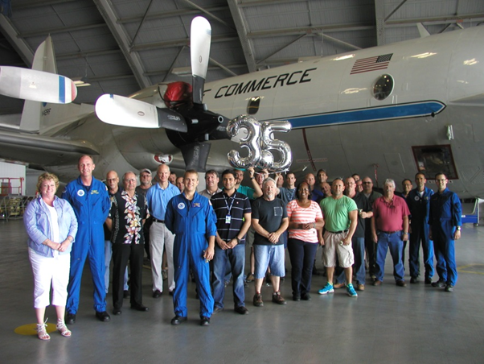
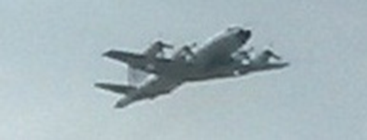
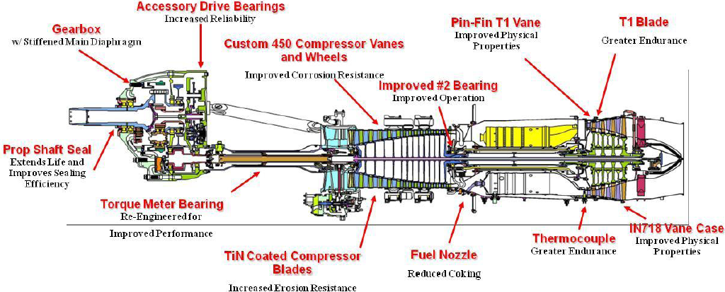
WP-3D Service Life Extension – Engine Upgrade
Scope
  Completely overhauled “zero time” engines
  Series III Reliability Enhancements
  Series 3.5 Enhancement Package
  Timeline
  Overhauled and Upgraded Test Engine – February 2014
  Test Program Instrumentation – March 2014
  Ground Testing – April 2014
  Flight Testing – April/May 2014
  Airworthiness Determination – November 2014
  Overhaul, upgrade and install on N43RF complete – May 2015
  Overhaul, upgrade and install on N42RF complete – October 2015
  Partners
  Rolls-Royce (Engine OEM)
  Lockheed Martin (Aircraft OEM)
  Segers Aero (Engine Overhauls)
  USAF Test Squadron (Technical Support)
  NAVAIR (Technical Support and Flight Support)
  Benefits
  10% Increase in Fuel Efficiency
  10% Increase in Operational Flight Time
  20% Reduction in Maintenance Costs
  NOAA leading the P-3 community

Slide 31
WP-3D Service Life Extension – Avionics Upgrades
  Communication Systems Replacement/Upgrade
    Digital HF Radios - N43RF
    2nd Channel High-Speed SATCOM
    Intercommunication System Upgrades
  Avionics Infrastructure Replacement/Upgrade
    Scientific Power Distribution Upgrades
    Wing Pylon Upgrades
    Systems Rack Redesign and Fabrication
    Floor Load Enhancements
  Flight Instrument and Display Replacement/Upgrade
    Instrument and Flight Display Refresh
    Autopilot Replacement/Enhancement
    Flight Data Recorders
    Nose Radar Replacement
    Wing Life Monitoring System
  Scientific Radar Replacement/Upgrade
    Tail Doppler Radar (TDR) Upgrades

Slide 32
QUESTIONS ?
Notes:
Least costly option.
High risk for missing hurricane season tasking..
2015 and 2019 season not covered.
42 chosen based on SLAP findings, costs, and schedule.
Assumes 300 hours per year on active aircraft.

